Slide 1
Social Determinants of Health
Ashish Kachru, President

Slide 2
About Altruista Health
Medical Management
Care Coordination
Population Health
Altruista Health, a HealthEdge company, was founded in 2007 on a mission to provide care management software that drives significant improvements in cost savings and health outcomes for all populations.
Our corporate headquarters is in Reston, VA and we have an office in HITEC City, India.
Our GuidingCare® platform is used by health plans to streamline care management workflows, facilitate coordination among clinical, behavioral and community resources, accelerate quality improvement and promote engagement with their members.
Top 70 Population Health Management
Companies to Know

Slide 3
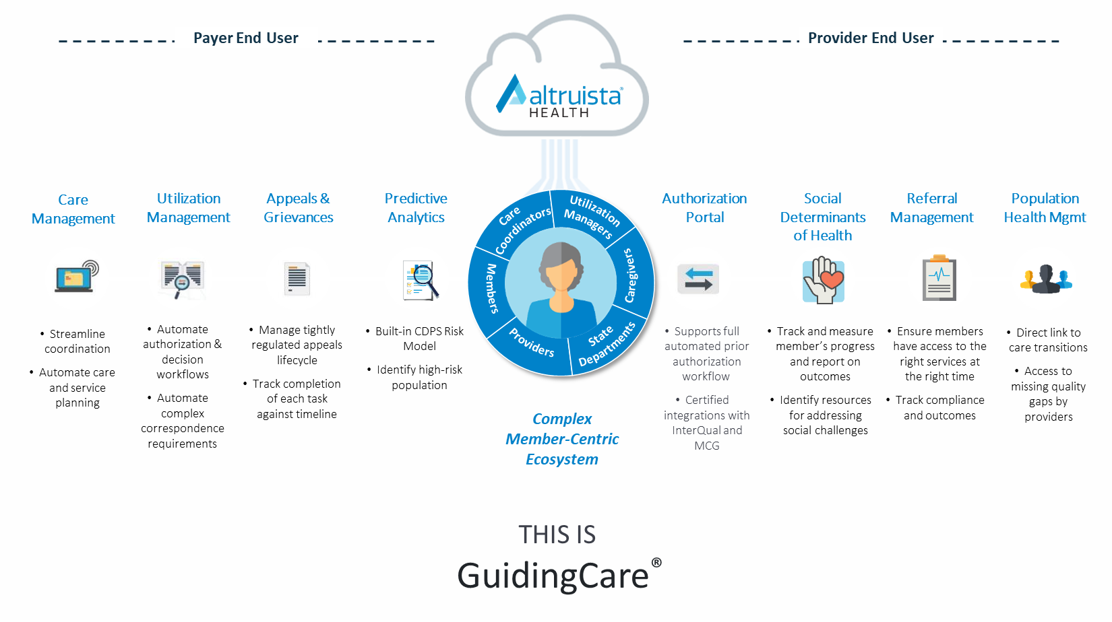
GuidingCare drives superior outcomes in a value-based, patient-centric ecosystem.

Slide 4
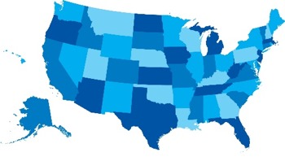
GuidingCare by the Numbers
5B⁺
50⁺
25⁺M
Contracted lives
on GuidingCare
Transactions per year processed on GuidingCare
Unique organizations operating on GuidingCare
5K⁺
50K⁺
Mobile users with online/offline capabilities
Users access
GuidingCare

Slide 5
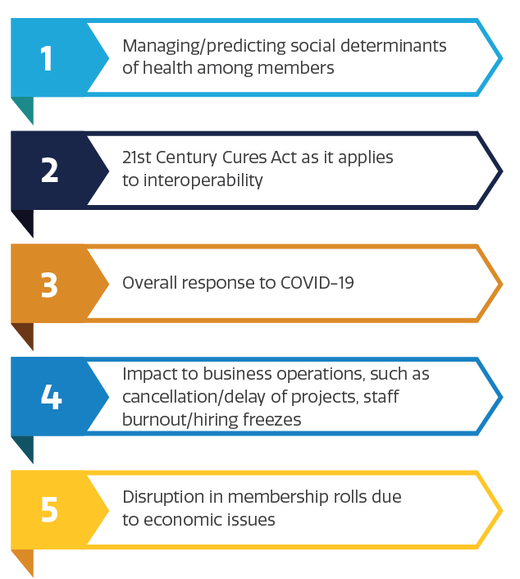
Altruista conducted a survey of U.S. health plans in August 2020 to measure top concerns.
#1 Challenge for Health Plans:
Managing/predicting social determinants of health among members
Altruista Health Annual Payer Index Survey – 2020.
Notes:
Altruista conducted a survey of U.S. health plans in August 2020 to measure their top concerns during the initial outbreak of COVID-19. 177 health plan leaders responded.
The most challenging issue reported with managing SDOH, even over managing COVID and the 21st Century Cures Act.
Managing and predicting social determinants of health among members
Interoperability as set out by the 21st Century Cures Act
Overall response to COVID
Impact to business operations, such as cancellation/delay of projects, staff burnout, hiring freezes, etc
Disruption in membership rolls due to economic issues

Slide 6
SDOH Impact
Impact on a member’s health is determined by:
40 percent by individual behaviors
30 percent by genetics
20 percent of health by “place” — where one lives, plus environmental factors
Just 10 percent of health is impacted by what we think of as “healthcare”
Impact on costs:
Social determinants are 40 percent of the cost structure in Medicare and Medicaid.
The Robert Johnson Wood Foundation estimates that just 20 percent of patients account for 90 percent of healthcare costs.

Slide 7
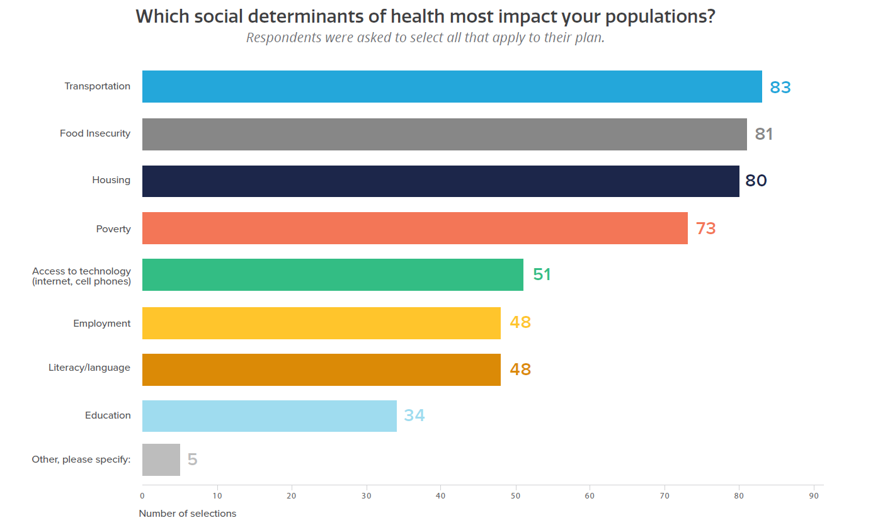
Top Social Determinants According to Health Plans
Altruista Health Annual Payer Index Survey – 2020.
Notes:
Social Determinants of Health (SDOH) were a top concern of many plans in the Altruista Payer Index Survey conducted in August. Health plans were asked which SDOH most impact their population and the most frequently mentioned factors were:
Transportation
food insecurity
Housing

Slide 8
Research demonstrates that improving population health and achieving health equity will require broader approaches that address social, economic, and environmental factors that influence health.
Kaiser Family Foundation

Slide 9
Evolution of SDOH Capabilities
Community Resource Directories
Needs Assessments and Screenings
Closed loop referrals
Value-based compensation
Purpose-built SDOH networks that drive value
Purpose-driven, accountable, contracted networks
Data-enable effectiveness and outcomes analytics
Community resources
SDOH Search and Referral
2013 | 2014 | 2015 | 2016 | 2017 | 2018 | 2019 | 2020 | 2021
Notes:
Market for SDOH solutions is evolving, growing, bifurcating.
Complexity, integration touchpoints, and price points vary widely.

Slide 10
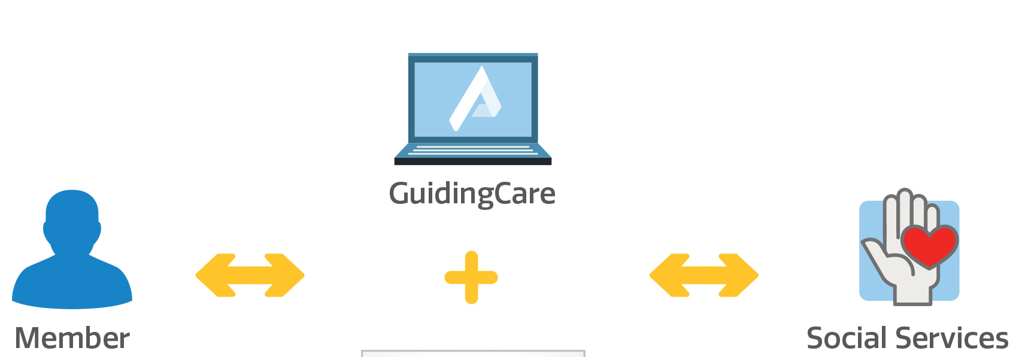
How GuidingCare Addresses SDOH
GuidingCare was one of the first care management platforms to integrate with leading social services search-and-referral platforms.
These integrations connect care managers with hundreds of local resources in housing, food, employment and financial assistance.
GuidingCare makes it easy to refer someone at the most opportune moment, increasing odds the member will take action.

Slide 11
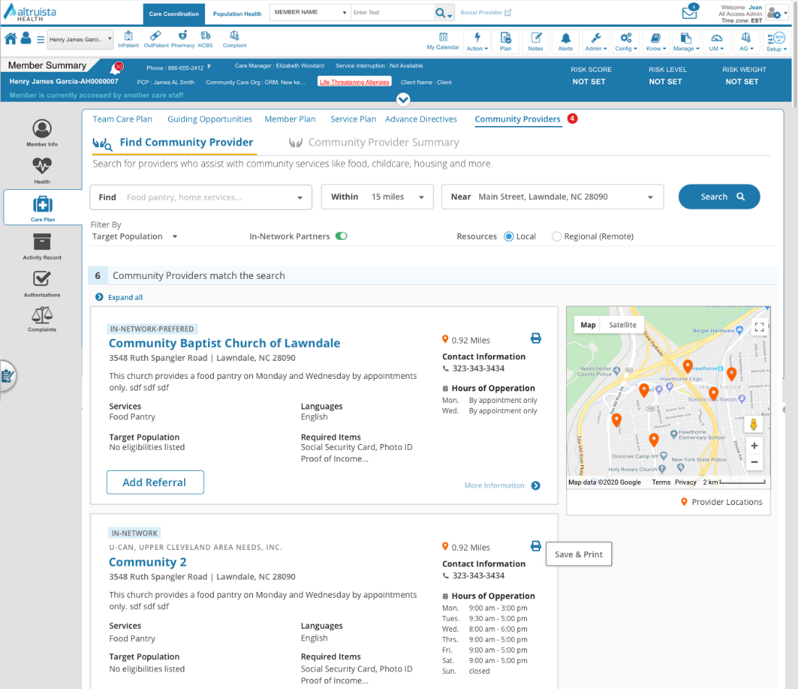
Finding a Community Provider or Resource
Care managers can easily find local providers and resources for members.
Full details are provided:
Services offered
Contact information and hours of operation
Required items for a referral
Referring a member to a provider is as simple as one click in GuidingCare

Slide 12
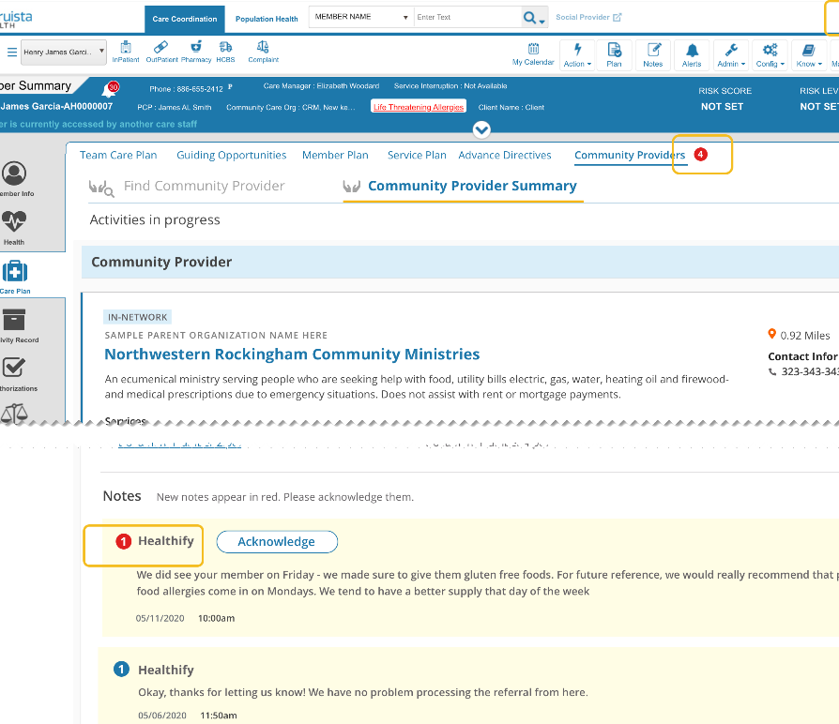
Real-time Updates
Updates made to the referral by the community provider will be pulled into GuidingCare real time.
A notification will be displayed to attract care coordinator’s attention.

Slide 13
Contact us for
more information
hello@altruistahealth.com
Ashish Kachru
President, Altruista Health
akachru@altruistahealth.com
Questions?
©2021 Altruista Health

